Slide 1
Firearm injuries II
Dr I. Kitulwatte

Slide 2
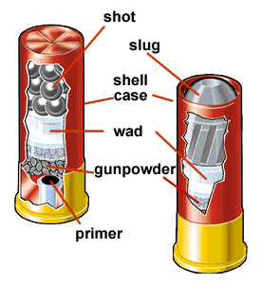
Shot gun injuries
Injuries may be contributed by:
Lead pellets
Soot in the form of smoke and debris
Unburned and burning propellant particles
Flame and hot gases under pressure
Carbon monoxide
Wads
Detonator constituents
Fragments of cartridge case

Slide 3
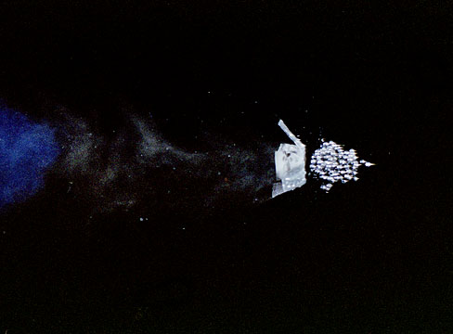
What happens once a shot is fired?
Initially the compact mass emerges
Begins to disperse:
Starts at about 2m
Separate satellite pellet wounds and central main hole after 1-2m
Spread of pellets increases and central wound disappear –mid to distant range

Slide 4
What happens once a shot is fired? Cont--
Flame and hot gases follow the shot
High pressure and temperature exists just outside the muzzle
Among the gases carbon monoxide is found
Soot from combustion of propellant and still burning propellant are expelled

Slide 5
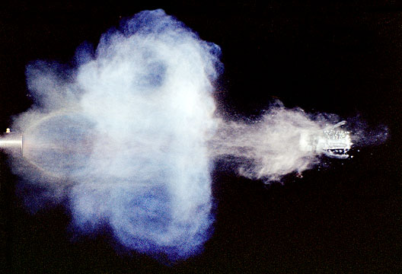
What happens once a shot is fired? Cont--
Wads are expelled
Traces of elements from detonator or percussion cap are expelled (can be detected from laboratory tests)
Fragments of cartridge case may also be ejected

Slide 6
Range of fire in shot guns
Depending on the type of shot gun
different barrel of same shot gun and different ammunition marked variations
Test firing is the ideal for determination of range.

Slide 7

Contact shotgun wounds
Shape
Single circular wound with approximate diameter of bore of the weapon (only on none bony areas)

Slide 8
Contact wounds over bones with thin soft tissue –
different appearance
large amount of discharged gas cannot dissipate
can have disruption of the cranium due to explosive effects
also can see gas reflected back by the bone
rises a dome of skin and subcutaneous tissue
press against muzzle – produce a muzzle imprint
split to form a cruciate/ stellate wound

Slide 9
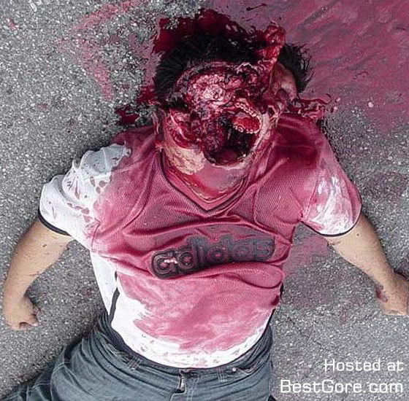
Massive disruption of skull

Slide 10
2. Burning and blackening
If a tight contact – minimal or none around
Recoil taking muzzle away or none firm contact – burning and blackening in the skin of immediate vicinity
If clothing intervene- soot escape sideways found in each layer of fabric, and underlying skin, clothe singed at the edge of hole and ring of burning around skin wound

Slide 11
3. Muzzle impression
Seen in a tight contact (holding the weapon firmly or when skin is lifted forcibly against)
Most useful indicator of contact wound
If double barrel weapon is used –muzzle mark adjacent to entry

Slide 12
4. Carbon monoxide
Produces due to incomplete combustion
When combine with haemoglobin /myoglobin-cherry pink colour
Useful in distinguishing entry from exit
5. Wads within the wound

Slide 13
Close range shot gun wound
muzzle is held near skin within 6 inches
Single circular wound
Singeing of hair around the wound
Burning of skin (narrow rim of hyperaemia or blistering)
Tissues around and in may be cherry pink from carbon monoxide

Slide 14
Close range shot gun wound cont--
Blackening due to soot/smoke – can get easily washed off
Powder tattooing around the wound – due to impact of un burnt partially burnt or burning gun powder, punctuate lesions (not washed off)
Shape of the wound is circular (weapon held right angles) or elliptical (weapon slanted)

Slide 15
Close range shot gun wound cont--
Appearance can be modified by clothing
Wad within the wound
If clothing present burning, blackening and tattooing may be absent.

Slide 16
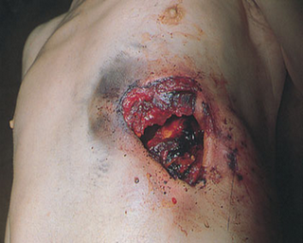
Close range shot gun wound chest

Slide 17
Intermediate range shot gun wound
6 inches to 6 feet
Burning and singing of hair disappears first
Soot soiling/blackening diminishes and vanishes in 8 -16 inches
Powder tattooing may persist further than this

Slide 18
Intermediate range shot gun wound
At 6feet/upper end of this range –crenated and scalloped edges of the wound (rat hole)
Satellite pellet wounds around the main wound
Wad mark associated with injury (laceration/bruise) - may be found below the main wound sometimes up to 5 meters

Slide 19
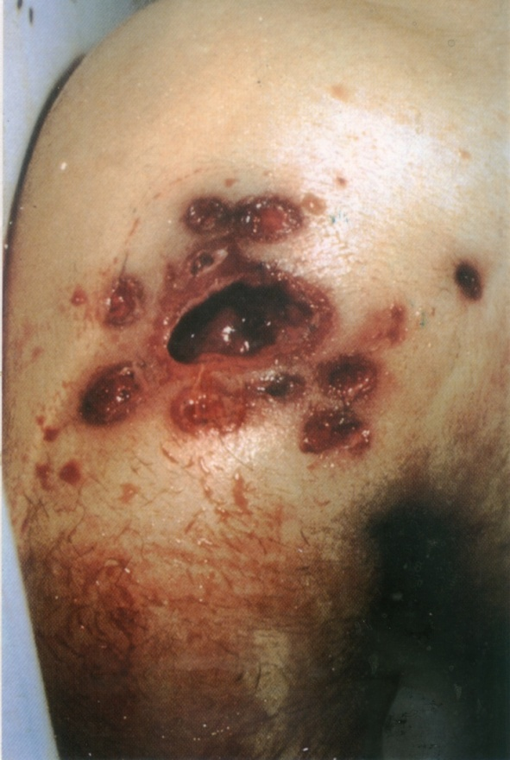
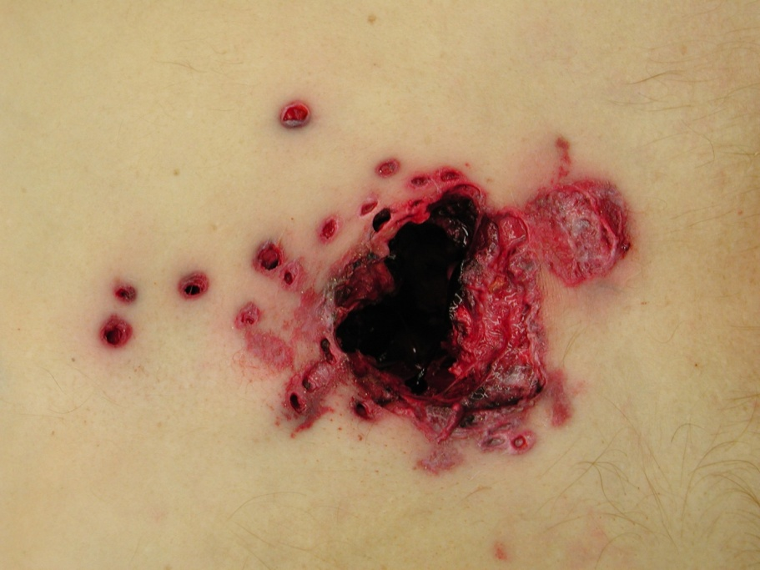
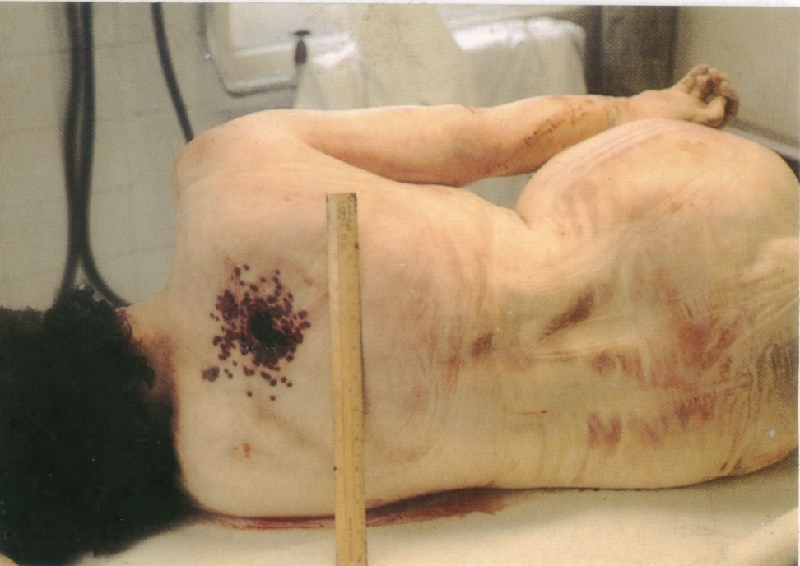
Intermediate range shot gun entry wounds

Slide 20
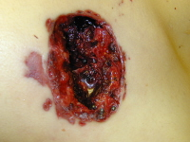
Wad mark

Slide 21
Distant or indeterminate range shot gun wound
no burning, smoke staining or powder tattooing
spread of pellets increases
central rat hole diminishes

Slide 22
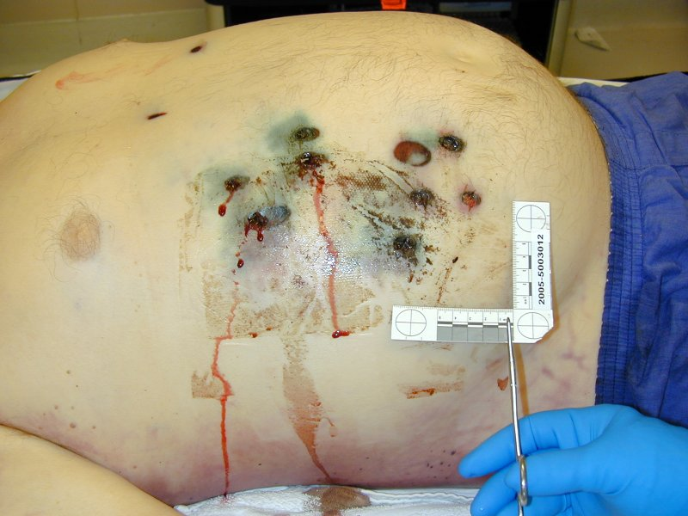
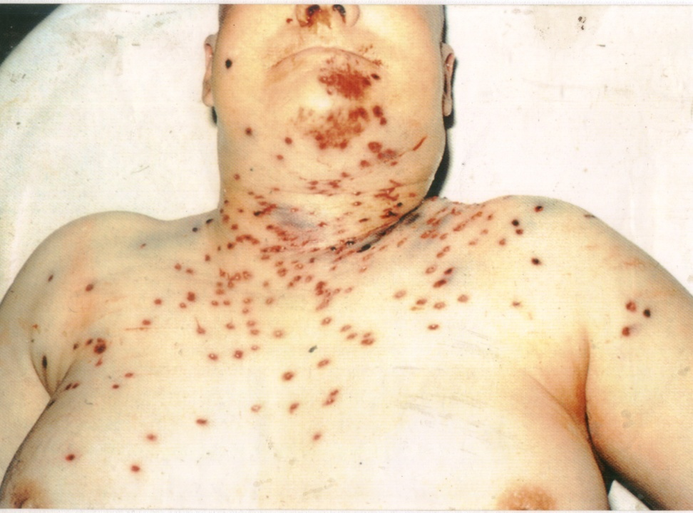
Shotgun entry wound distant range

Slide 23
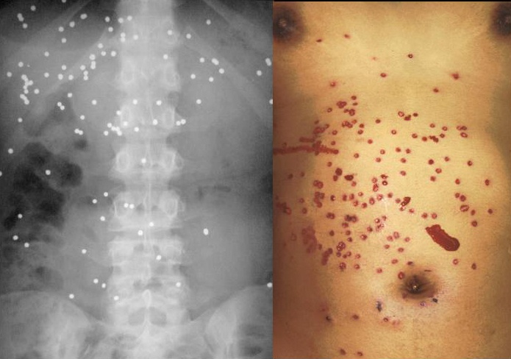
Shotgun entry wound distant range

Slide 24
Direction of shot gun injury
Right angle-circular hole and associated other factors
Other positions –elliptical
Shelving and undercutting are helpful
Track of wound in deeper tissues (radiographs are much beneficial)
But the track is difficult to determine
Internal damage is diffuse and associated with disruption
Is caused by direct mechanical disruption (by gas and shot)
No cavitation effect

Slide 25
Secondary damage
Can occur by mass of pellets striking a bone and releasing fragments as secondary missiles
Can emerge resulting in exist- (can be mistaken for multiple shots)

Slide 26
Shotgun injuries in bones
Usually destroys a larger area of the skull
In a thin bone like cranium, sternum or pelvis there is usually a special pattern called beveling
Individual pellets – rarely penetrate
Thicker bones are involved result in comminuted fractures and bony fragments can acquire a velocity causing secondary injuries.

Slide 27
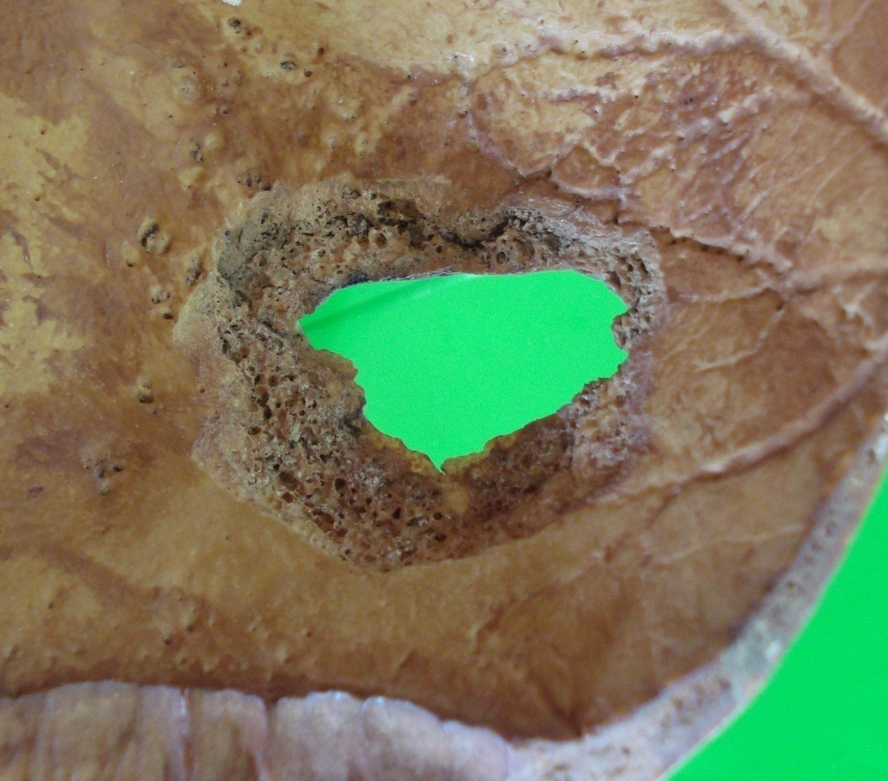
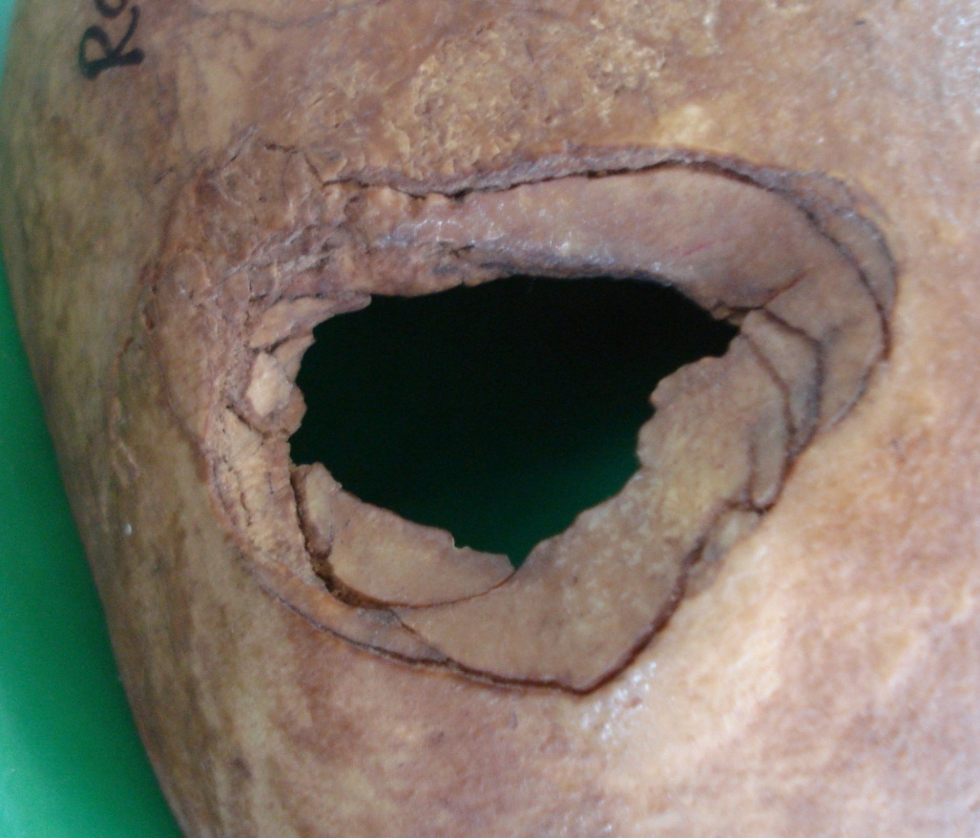
Shot gun entry with beveling

Slide 28
Shot gun exit wound
Uncommon in the trunk as energy not enough to pass through
Head, neck and limbs may have exit wounds
Range of fire is a determining factor for exit wound (specially in contact and close range)
The appearance of exit depends on the anatomical part injured

Slide 29
appearance of exit depend on the anatomical part injured
Extremely ragged, irregular and large with everted edges
Disrupt the tissues due to large volumes of gases
Comminuted bone fragments
Shot gun fired into the mouth may remove a large portion of the back of the head as an exit wound- burst head (gas plays a role)
Chest or abdomen often fail to exit
Pellets often penetrate the distal chest wall –held up beneath the skin (Bruises seen)

Slide 30
Mechanism of death
Haemothorax due to damage to pleura and lungs
Haemopericardium
Intracranial damage from shattering of skull and facial bone

Slide 31
What are elective sites for suicide?
Temple
Mid forehead
Intraoral
Under the chin
Left chest/mid chest

Slide 32
Summary
Entry wound of a shot gun is single and circular in contact and close range discharges while in intermediate range discharge there are satellite pellet wounds around the main wound
Distant range shot gun entry wounds show injuries from single pellets.

Slide 33

Thank you!

